Slide 1
Unit II
TCP/IP Basics & Routing

Slide 2
IP Address Internet Protocol Address (IP Address) is a numerical label assigned to each device connected to a computer network that uses the Internet Protocol for Communications. IP Address serve two main functions:
Location addressing
(Provide the location
of the device within the
Network allowing communication
Between the device)
Identification (Identify a specific device on a
network like computer and
smartphone or server)

Slide 3
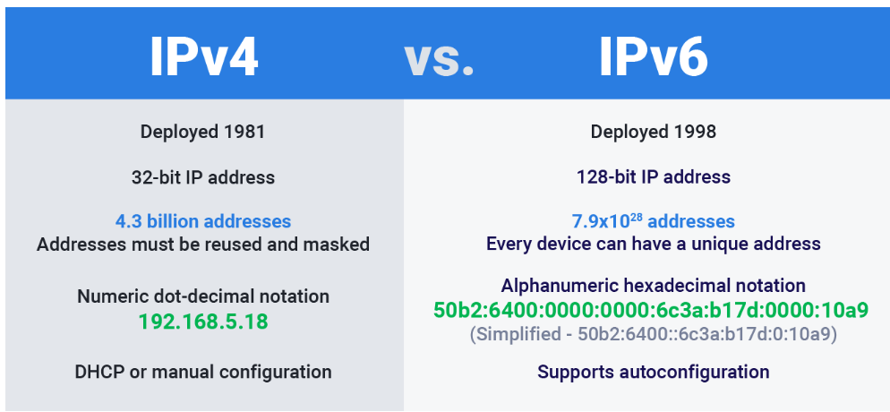
Type of IP Address

Slide 4
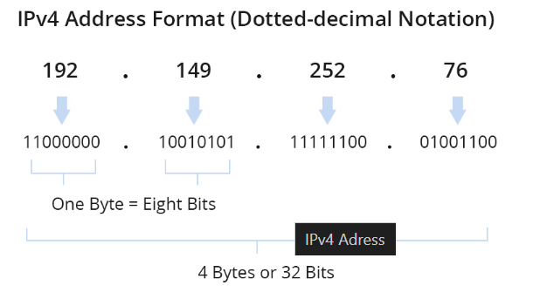
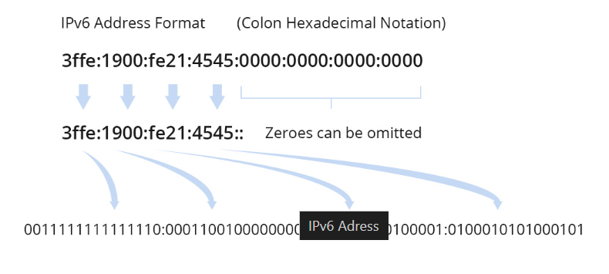
Collection

Slide 5
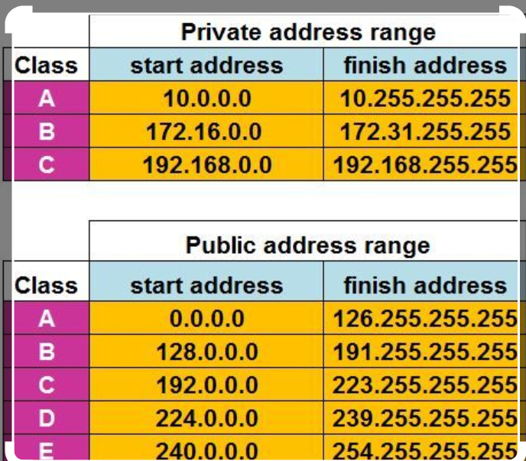
Types of IP Addresses Public IP Address

Slide 6
Public IP address assigned by your internet service provider (ISP) and used to identify devices on the broader internet. Public IPs can either be dynamic (changing over time or Static (Fixed). Private IP Address (Used within a local network e.g., home, office) Private IPs cannot be accessed directly from the internet.

Slide 7
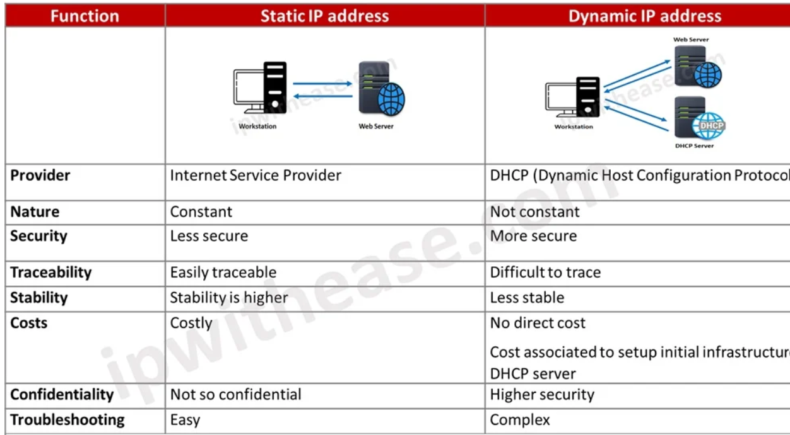
Type of IP Address Static and Dynamic

Slide 8
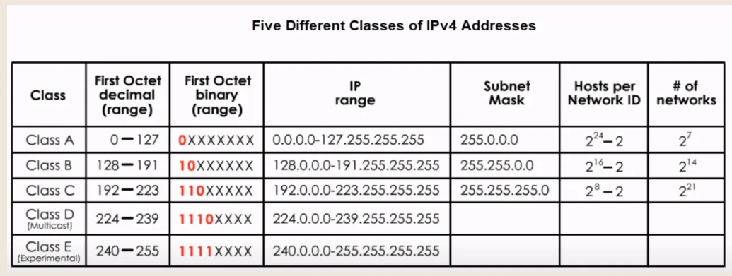
IP Address Class

Slide 9
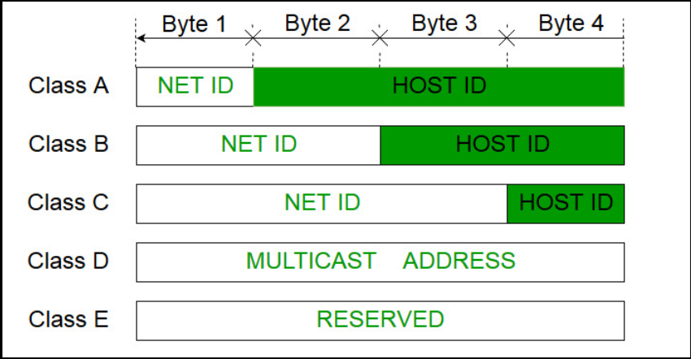
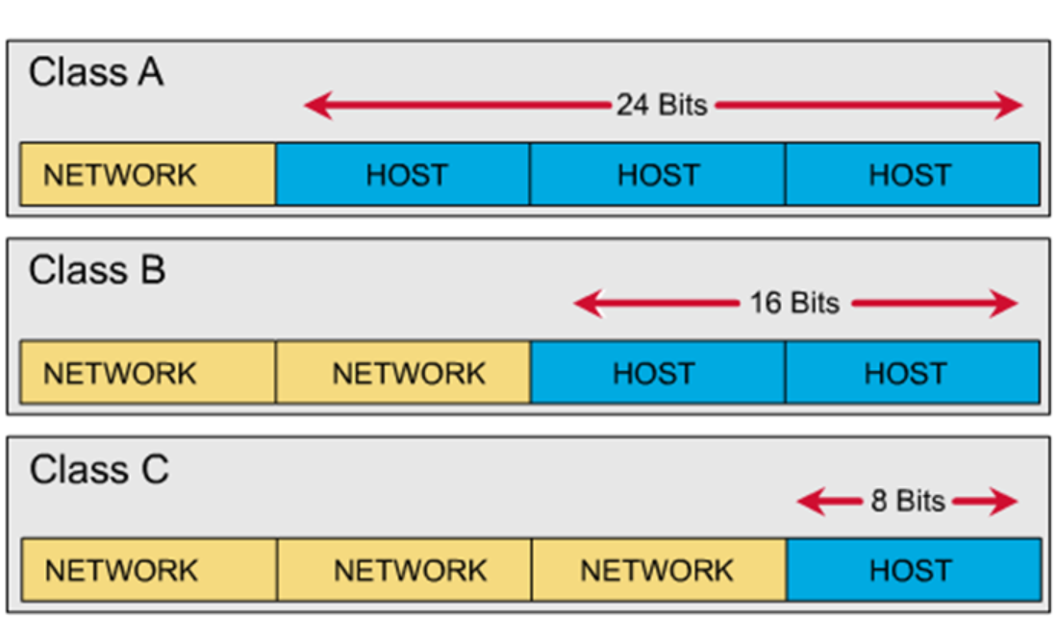

Slide 10
Need for subnetting: Subnetting is the process of dividing a large network or IP address space in to smaller, More manageable sub-networks, called subnets. It enhances the efficiency of IP address allocation and improves network security and performance.

Slide 11
1. Efficient IP Address Utilization (IP address conservation- without subnetting, IP address can be wasted, Reduction of waste – by breaking down large network into subnets) 2. Improved Network Performance (Decreased Traffic, Smaller Broadcast Domains) 3. Simplified Network Management (Logical Grouping of Device- Subnetting allows for grouping devices based on departments, floor, or other logical divisions making easier to manage the network) and Easier Troubleshooting to specific network e.g. Sales, Purchase, IT etc., 4. Enhanced Network Security (Isolation of Subnet, Use of Access Control by segmenting the network administrator can apply security policies and access control to individual subnets.)

Slide 12
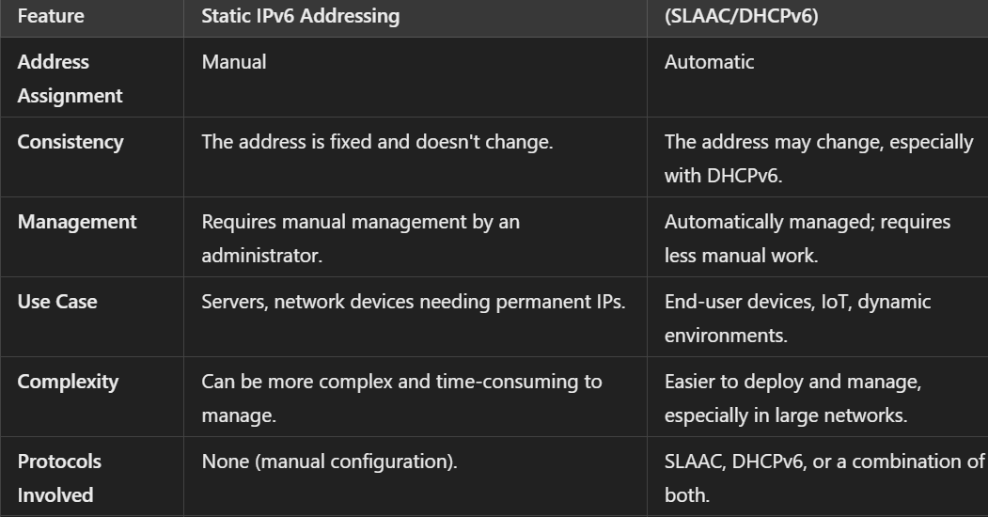

Slide 13
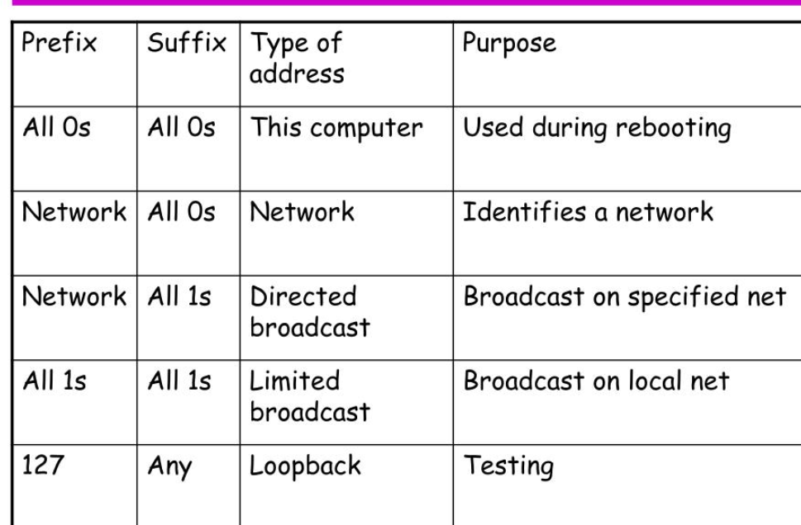
Special or Reserved IP Address: (There can be an entire block of addresses reserved for special addressing or there can be some addresses in each block that are reserved for special addressing)

Slide 14
Tools for Troubleshooting IP Problems: When troubleshooting IP-related problems, several tools can be used to diagnose and resolve issues in both IPv4 and IPv6 networks. 1. Ping ---- ping www.facebook.com or ping with IP address 2. Traceroute (Linux/macOS) and for Windows (Tracert)---- Tracert Ip address 3. ipconfig (Windows), Ifconfig or IP for Linux/ macOS. 4. Nslookup ---- nslookup www.facebook.com (Queries DNS to map domain names to IP Address) 5. Dig (Linux / macOS) – dig www.facebook.com A powerful DNS llokup utility used to query DNS servers and troubleshoot DNS Issues.

Slide 15
6. Netstat --- netstat –an to display all active network connections. 7. ARP (Address Resolution Protocol) --- arp –a Windows | Linux / macOS arp –n 8. pathping ---- pathping 192.168.1.1 (A combination of ping and Traceroute, providing details about network latency and packet loss at each hop) 9. Tcpdump (Linux and MacOS) for packet analyser used to capture and analyse network traffic. Tcpdump –i eth0 10. Wireshark (Windows, Linux, MacOS)- Packet inspection, Protocol analysis, and troubleshooting complex IP problem like packet loss.

